Slide 1
INTERNSHIP REVIEW - 1
NAME : MANGESH BALASO PAWAR
PRN NO : 22010853
CLASS : Btech
Email : mangesh.22010853@viit.ac.in
Department : Artificial Intelligence And Data Science

Slide 2
About Internship Details
Organization Name : The Institution Of Engineering and Technology
Designation : Data Scientiest Intern
Period Of Internship : 6 Months
Industry Mentor : Mr. Ashwini Kumar Saxena
Faculty Mentor : Mr. Mandar Diwakar

Slide 3

About Company
Organization Name : The Institution Of Engineering and Technology
About : The IET is one of the world’s largest engineering institutions with 154,000 members in 148 countries. The IET is working to engineer a better world by inspiring, informing and influencing our members, engineers and technicians, and all those who are touched by, or touch, the work of engineers.

Slide 4
Problem Statement
The agriculture industry faces a significant challenge in predicting crop yield production and crop demand accurately. The traditional methods of predicting crop yield and demand are time-consuming and can be prone to errors, leading to inefficient use of resources and revenue loss. There is a need for predicting the most suitable crop based on various influential factors and forecasting the profitability.

Slide 5
Objective
To develop an intelligent platform that uses machine learning algorithms to estimate the most suitable crop for cultivation in a given area based on environmental factors.
To forecast market demand and pricing trends for the identified crop, with the aim of increasing profitability for farmers and stakeholders in the agriculture industry.

Slide 6
My Responsibility
1. Collect data from various sources.
2. Preprocess data to clean and standardize it.
3. Perform exploratory data analysis.
4. Work on machine learning and deep learning models.
5. Build robust and scalable models for price forecasting.
6. Develop a web-based application.
7. Deploy the application on a cloud platform.

Slide 7
Modules
This project contains 3 main modules:
Crop Prediction
Crop Price Estimation
Application interface development

Slide 8
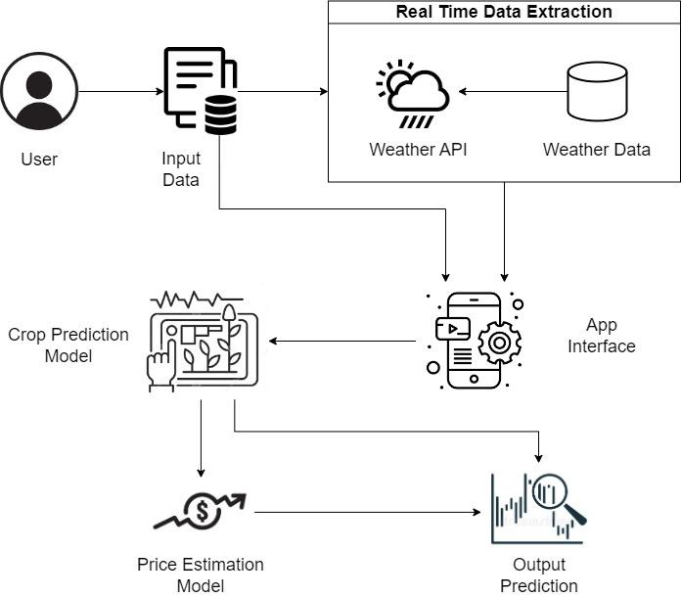
High Level Architecture

Slide 9
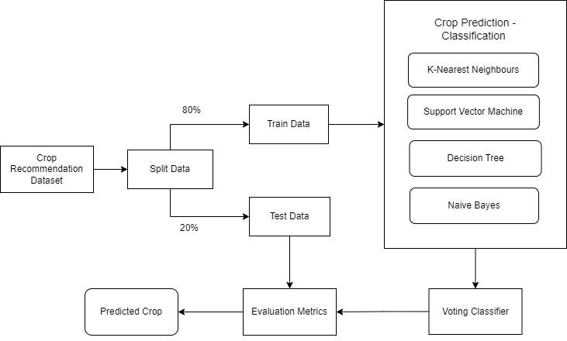
ALGORITHM FLOW DIAGRAM - CROP PREDICTION

Slide 10
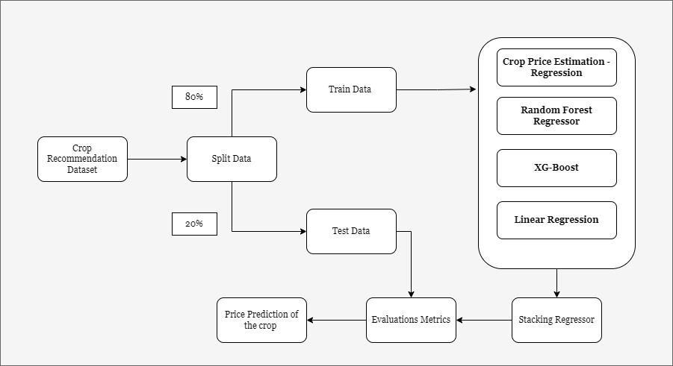
ALGORITHM FLOW DIAGRAM - PRICE ESTIMATION

Slide 11
Key Learning Till Now
Collecting Raw data and cleaning data
Data preprocessing
Working on seven different models related to time series forecasting and machine learning model.
Best Results from Ensemble Learning Algorithm
Final Decision: Stacking Regressor as the Robust Model
Learning Big Data Technology

